Slide 1
School Assistance Dashboard
Made by:
Hosanna Pyles
Thomas Ewing
Saulo Contreras
Awsaf Ahmad Kabir
Faiz Khan
Govind Rangappa
Joshua John

Slide 2
Agenda
01. Project Objectives
04. Requirements
02. Cost Estimation
05. Diagrams
03. Project Timeline
06. Architectural Design

Slide 3
Project Objectives

Slide 4
Project Objectives
OBJECTIVE 1
OBJECTIVE 2
OBJECTIVE 3
Calculating current Class Grades and Term GPA
Ability to automate integration of custom Grade scales
Keep track of class attendance and Assignments due

Slide 5
Cost Estimation

Slide 6
Cost Estimation
How are we doing it?
Application Composition Model
Many UI Screens + Reports + separated Logic Modules
A part of COCOMO II Software Cost estimation suite
This model estimates Effort based on calculating the Object Points
  Screens, Reports, Modules
Effort = # OP / Productivity

Slide 7
Cost Estimation
SCREENS (10)
Reports (3)
Login Page
Home Page
Attendance Tracker Page
Edit Attendance Form
Grade Calculator Page
Syllabus Upload Page
Parsed Syllabus Page
Assignments tracker Page
Grade calculator Page
Settings Page
Attendance Summary Report
Grade Summary Report
Predicted Result Report
Logic Modules (5)
Grade Calculation Logic
Attendance Logic Module
Syllabus Scraping & Parsing Module
Assignment Reminder Logic
Data Handler
Total Count = 10 + 3 + 5 = 18 OP
Effort = OP / Productivity
18 / 10 = 1.8 person-month

Slide 8
Cost Estimation
• Effort = 1.8 person-months (based on 18 Object Points ÷ productivity 10)
• Development Cost ≈ $18,000 (1.8 person-months × $10,000 per month)
• Hardware Costs ≈ $1,290 (cloud hosting, laptop depreciation, backup drives)
• Software Costs ≈ $60 (Acrobat tools; IDEs/GitHub free for students)
• Misc Costs ≈ $400 (training material, documentation, deployment)
• Calculated Total ≈ $19,750
• Predicted Mark-Up = 1.20 × Total ≈ $23,700
• Final Estimated Cost ≈ $23,000–$24,000

Slide 9
Project Timeline

Slide 10
Project roadmap
Aug 25 – Sep 5, 2025
Sep 8 – Sep 26, 2025
Sep 29 – Oct 17, 2025
Oct 20 – Oct 31, 2025
Nov 3 – Nov 14, 2025
Initialization & Scope
Planning & Production Phase 1
Planning & Production Phase 2
Launch / Final Integration
Closing & Post-Launch
Define the project vision, goals, feasibility constraints, and requirements.
Complete architecture, diagrams, designs, and build each feature incrementally.
This phase contains work on System Architecture, the Grade Calculator, and Attendance Tracking.
Complete architecture, diagrams, designs, and build each feature incrementally.
This phase contains work on UI Integration, Syllabus Scraping, and Data Handling Tasks.
Final development, system-wide testing, UI refinement, and presentation prep.
Documentation finalization + retrospective + cleanup after submission.

Slide 11
Project timeline
Week 1
Week 2
Week 3
Week 4
Week 5
Week 6
Week 7
Week 8
Week 9
Week 10
Week 12
Week 13
Initialization & Scope
Planning & Production
Phase 1
Planning & Production
Phase 2
Launch / Final Integration
Closing / Post-Launch

Slide 12

Project phase:
Initialization & Scope
Tasks in This Phase
Requirements Gathering
Identify functional requirements (grade calculator, attendance tracker, scraping, etc.).
Identify non-functional requirements (usability, scalability, portability).
Validate assumptions:
  Syllabi in .pdf/.docx formats
  Access to UTD eLearning API
  Legal access to course data
Draft initial problem statement.
Scope Definition
Identify primary deliverables.
Prioritize features for the incremental model.
Define minimal viable product (MVP):
  Basic grade calculator
  Attendance tracker
  Assignment tracking input feature
Documentation
Initial SRS (requirements document)
Task delegation (revised per grader feedback)
Initial schedule and risk assessment.

Slide 13

Project phase:
Planning & Production Phase 1
Tasks
Hosanna & Govind → Draft high-level architecture.
Class diagram, use case diagram, sequence diagrams (team-wide effort).
Thomas & Faiz → Build the grade calculator module (weights, curves, projections).
Awsaf → Integrate front/back-end foundation (ASP.NET structure).
Saulo → Core attendance logic and data structures.
Joshua → Integration support + documentation updates.
Deliverables
Architectural design section (already in your file).
First working module: Grade Calculator MVP
Attendance Tracker MVP
Updated diagrams if necessary

Slide 14

Project phase:
Planning & Production Phase 2
Planning & Production Phase
Tasks
Hosanna → Front-end UI screens for attendance & grade calculator.
Awsaf → Backend connection and database mock integration.
Awsaf & Faiz → Build syllabus scraping prototype.
(Everyone) Parse assignment categories, weights.
(Everyone) Error handling for missing syllabus data.
(Everyone) Unit tests for scraping robustness.
Deliverables
UI + functionality integration with Increment 1
Syllabus Scraper MVP
Fully integrated early version of the School Assistance Dashboard (SAD)
Updated task delegation based on implementation discoveries

Slide 15

Project phase:
Launch / Final Integration
Tasks
Full Pipeline Integration
Merge all modules in GitHub repository (Awsaf manages).
Check architecture compliance across components.
Testing & Validation
Govind → Coordinate unit and integration testing standards.
All members → Perform user-like scenario testing:
  Grade simulation
  Attendance updates
  Syllabus importing
Bug Fixing
Fix UI inconsistencies, schema mismatches, broken scraping cases, etc.
Documentation & Presentation
Team → Prepare final presentation slides.
Write final report sections (Design, Implementation, Testing, Lessons Learned).
Deliverables
Fully functional application
Final class demonstration build
Updated SRS + design document

Slide 16

Project phase:
Closing & Post-Launch
Tasks
Final edits to deliverables.
Write post-launch evaluation:
What worked?
What didn’t?
Recommendations for future developers.
Repository cleanup and tagging final release version.
Submit all deliverables to instructor.
Deliverables
Final written report (cleaned, professionally formatted)
GitHub release version 1.0
Project presentation
Lessons learned

Slide 17
Func/Non Func Requirements

Slide 18
Assumptions
Syllabi will be available in .pdf or .docx format.
We are legally allowed to access class information.
Data is compatible with a ASP.NET Core web application.
We will have access to the UTD eLearning API calls.

Slide 19
Functional Requirements
Non Functional
Requirements
The product must be able to calculate the overall grade based on weights provided by the syllabus
The product must handle a variety of grading schemes of professors
The product must Keep track of assignments that will be submitted with reminders for all
Scalability: the system should scale up and down to different operating systems; both laptops and mobile devices
Portability: should be accessible/easy-to-use on platforms outside the main website
Reliability: the system should not crash when permissions or information are unavailable
Reasoning
Reasoning
This allows for calculation of existent scores and potential scores needed for planning
This allows for curves and dropping of scores prior to the final deadline for grades li
Tracking future assignments allows for future planning and increased utility
(Both Scalability and Portability Requirements) This increases accessibility, providing utility to more users
This would now provide fault tolerance against unauthorized data access, ensuring correct usage

Slide 20
Use Case Diagram

Slide 21
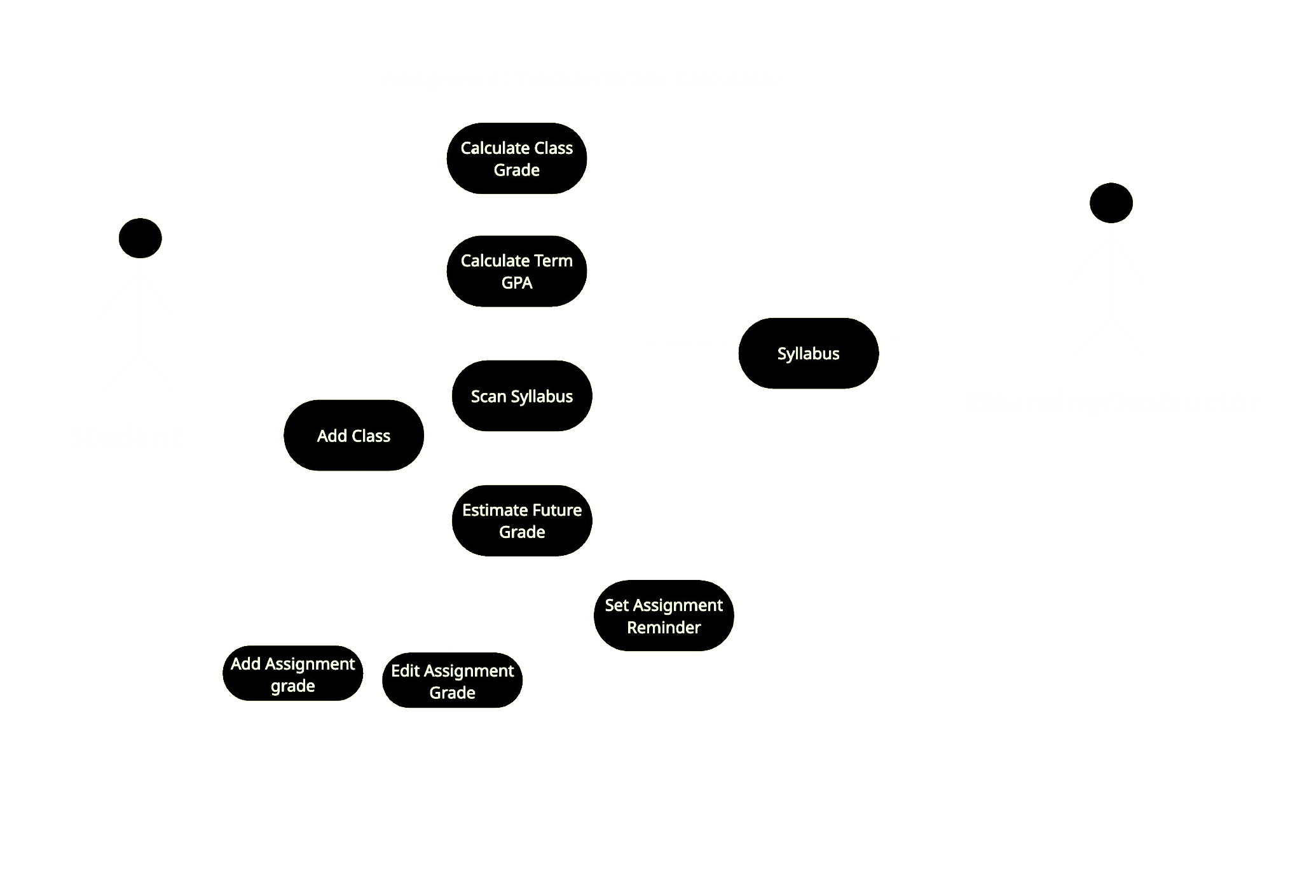
USE-CASE DIAGRAM
Student is main actor
Adds classes, enters grades, scans syllabus
Instructor/e-Learning provides syllabus
System extracts weighting + class structure
Core features
Grade calculator, GPA calculator, future grade estimate, reminders
System goal
End-to-end grade tracking based on syllabus data

Slide 22
Sequence Diagram

Slide 23
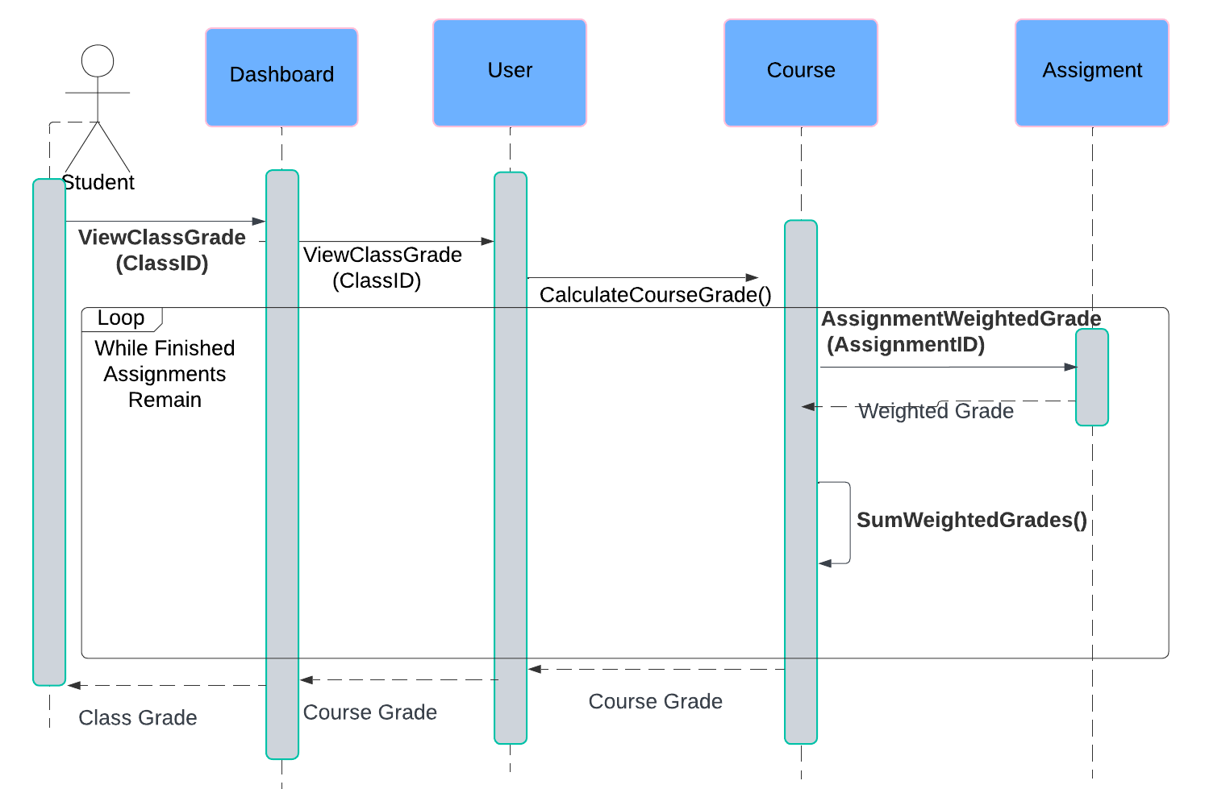
Calculate Class Grade: Takes the grades for submitted assignments weighted by the class grading scales and returns the weighted grade for the class.

Slide 24
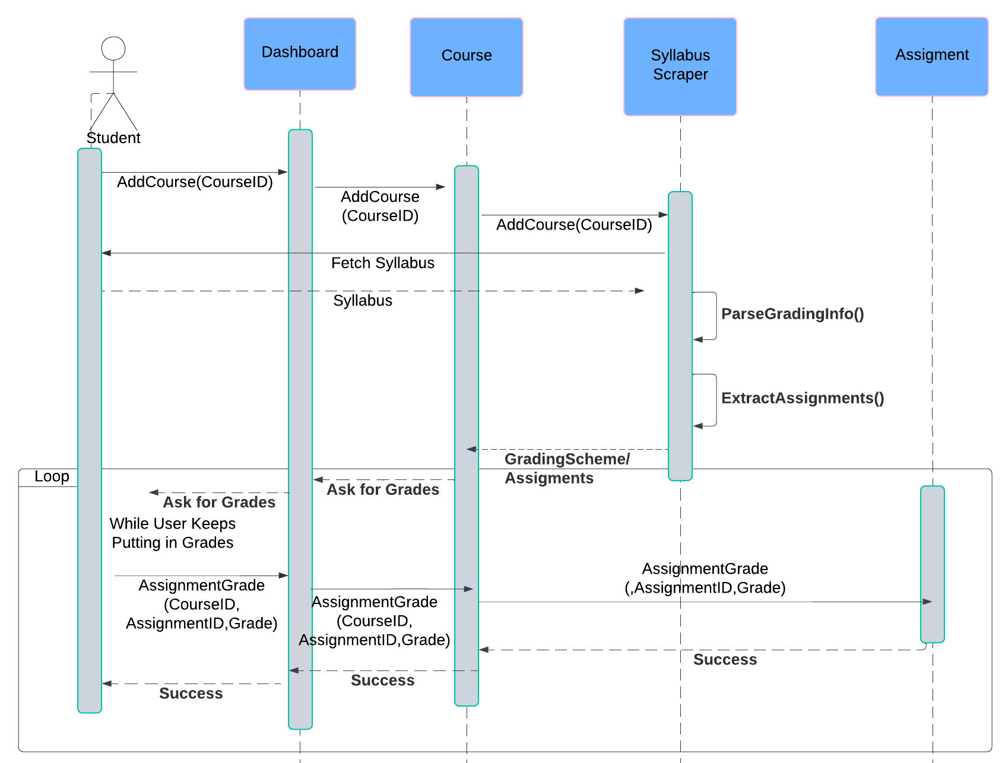
Add Course: Adds an additional course, asking for gradings scales as well as assignments and their grades

Slide 25
Class Diagram

Slide 26
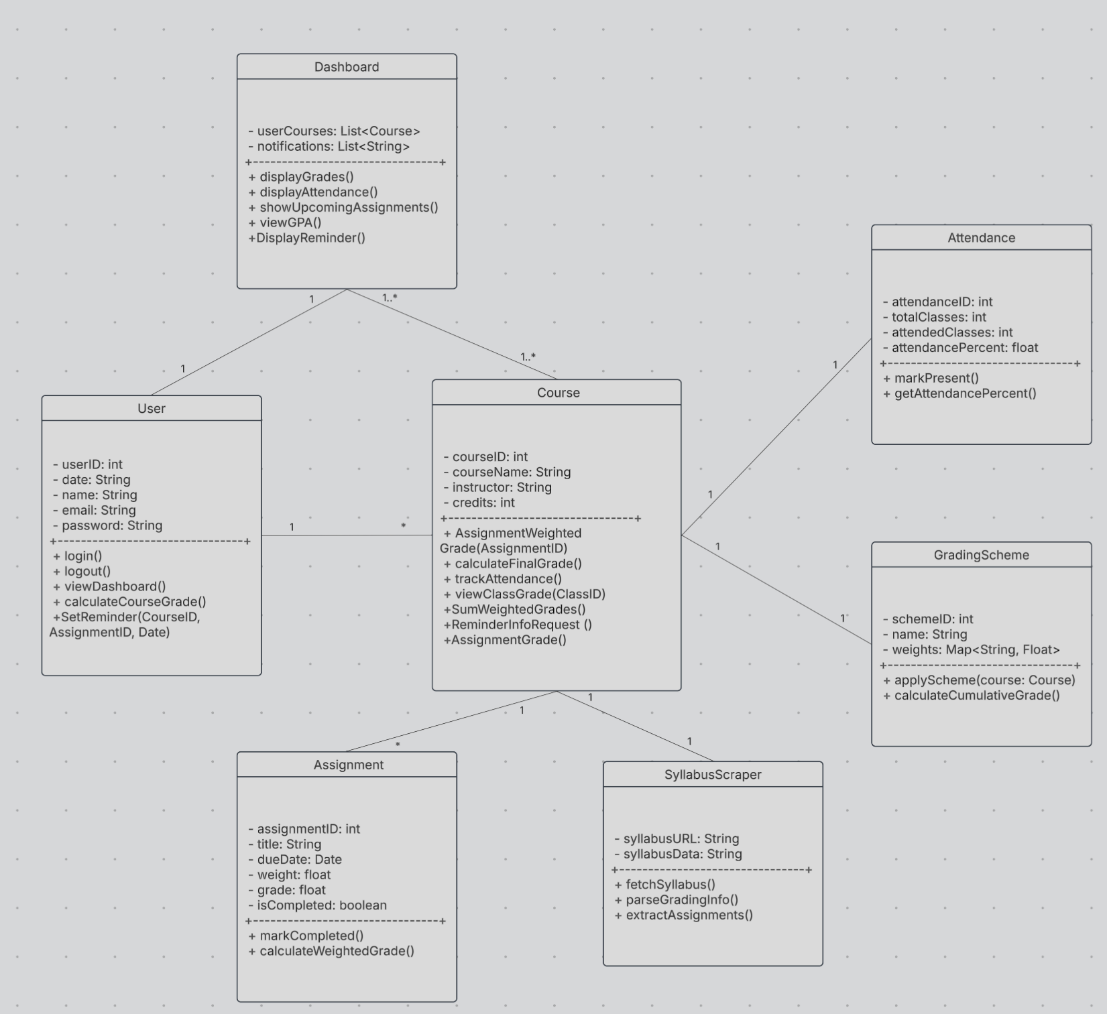
User: main actor; manages dashboard, classes, reminders
Course: stores class info; handles grade + attendance logic
Assignment: tracks individual assignments & weighted grades
Syllabus Scraper: extracts weights and assignments from syllabus
Attendance: calculates attendance percentage
Grading Scheme: applies weight mappings to compute cumulative grades
Dashboard: displays grades, GPA, reminders, upcoming tasks

Slide 27
Architectural Design

Slide 28
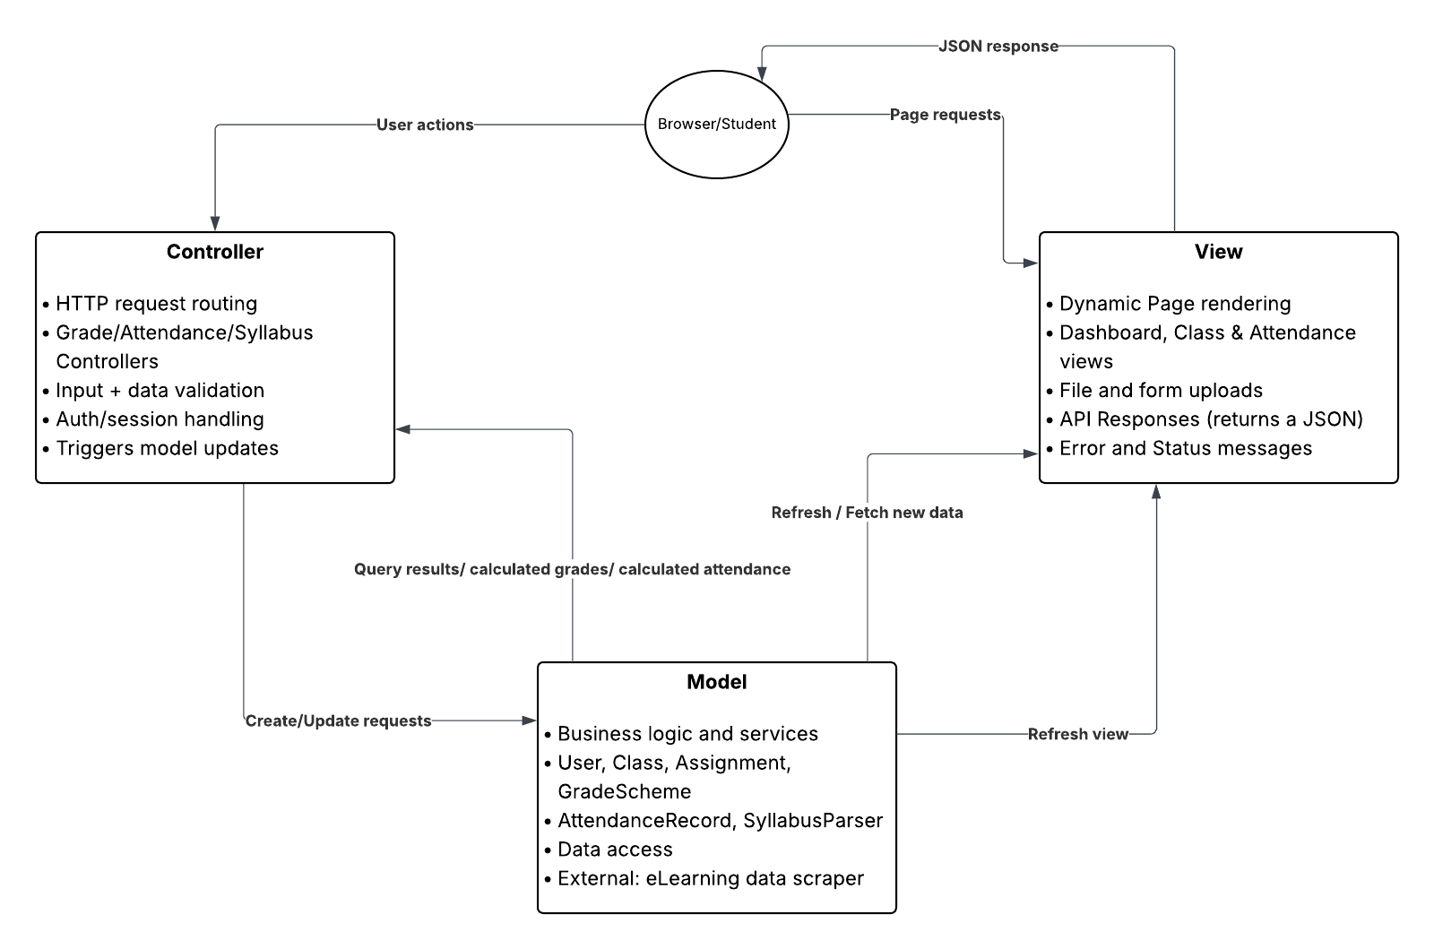
Architectural Design
System uses MVC architecture for clean separation of logic from View, Model, to Controller.
Best suited for Web Applications
Controller: validates input, manages auth/session, routes requests and triggers model updates
View: renders dashboard, class pages, attendance views; handles uploads & API responses
Model: contains business logic (grades, attendance, assignments, syllabus parsing, data access)
Flow: student action → controller processes → model computes → view updates with new data

Slide 29
Any questions? Ask away!

Slide 30
Thank you

